Slide 1
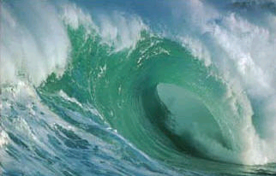
Waves

Slide 2

What is a wave?
A wave is a traveling disturbance that carries energy through space and matter without transferring mass.
Note how the ball on the surface stays relatively in the same place while the wave continues to move or propagate from left to right.

Slide 3
Types of Waves
Mechanical Waves: Require a material medium* such as air, water, steel of a spring or the fabric of a rope.
Electromagnetic Waves: Light and radio waves that can travel in the absence of a medium.
* Medium = the material through which the wave travels.

Slide 4
Types of Mechanical Waves
Transverse Wave: A wave in which the disturbance occurs perpendicular to the direction of travel (A string).
Longitudinal Wave: A wave in which the disturbance occurs parallel to the line of travel of the wave (Sound).
Surface Wave: A wave that has characteristics of both transverse and longitudinal waves (Ocean Waves).
  Wave types

Slide 5
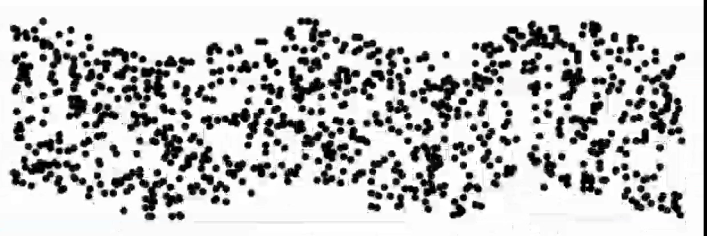
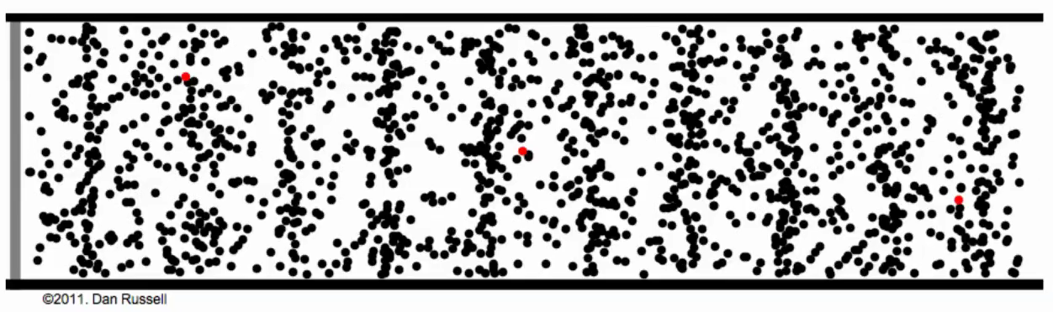
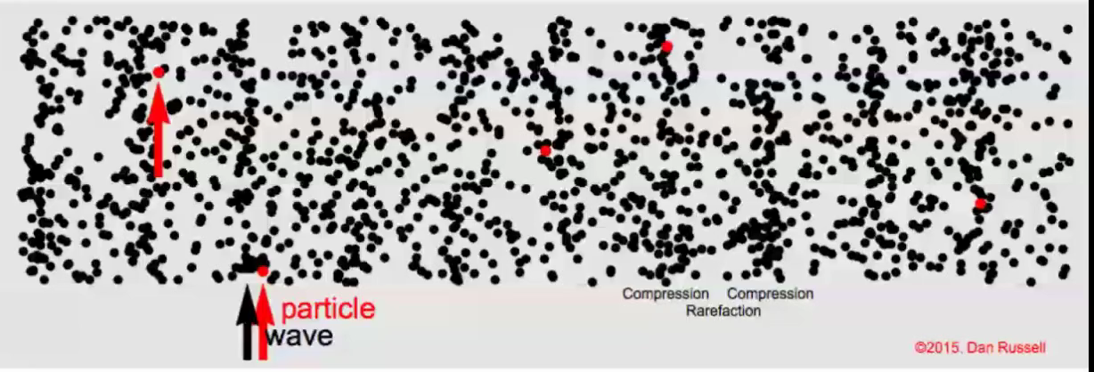
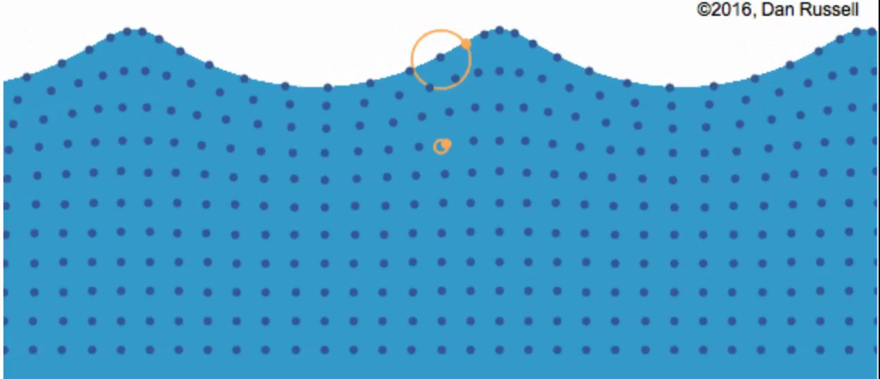
Transverse:
Longitudinal:
Longitudinal:
Surface:

Slide 6
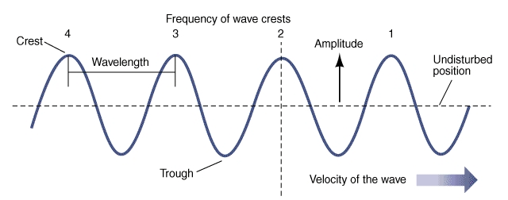
Transverse Wave Characteristics
Crest: The high point of a wave.
Trough: The low point of a wave.
Amplitude: Maximum displacement from its position of equilibrium (undisturbed position).
John Wiley & Sons
Note: Amplitude is a measure of the energy of a wave!

Slide 7
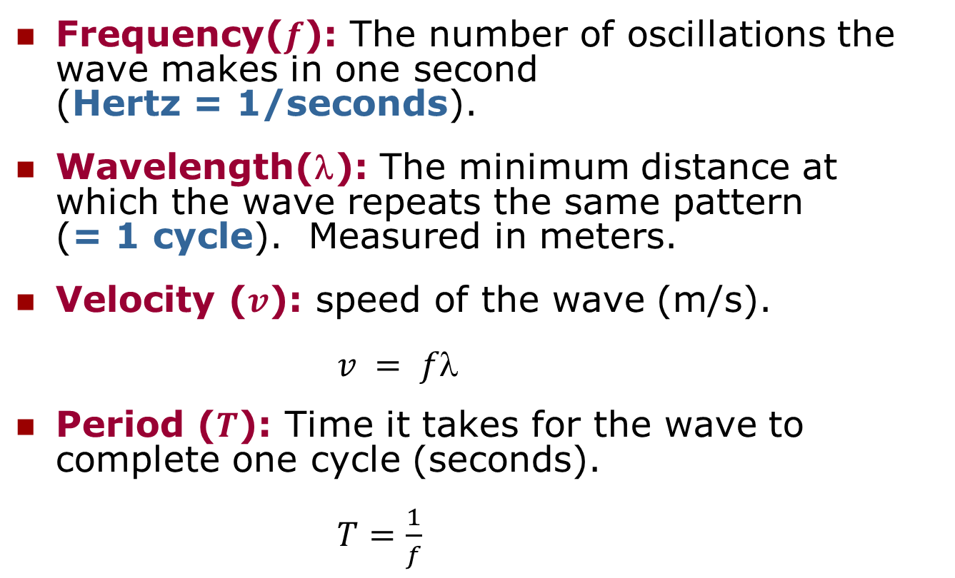
Transverse Wave Characteristics (cont.)
Frequency($f$): The number of oscillations the wave makes in one second (Hertz = 1/seconds).
Wavelength(λ): The minimum distance at which the wave repeats the same pattern (= 1 cycle). Measured in meters.
Velocity ($v$): speed of the wave (m/s).
$v = f$
Period ($T$): Time it takes for the wave to complete one cycle (seconds).
$T=\frac{1}{f}$

Slide 8
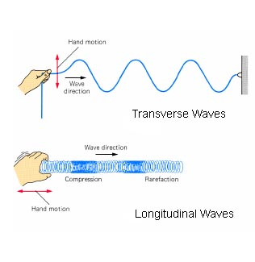
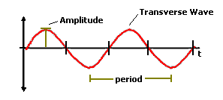

Transverse vs. Longitudinal Waves

Slide 9
The Inverse Relationship v = fλ
The speed of a wave is determined by the medium in which it travels.
  That means that the speed is constant for a given medium
    Therefore, the frequency and wavelength must be inversely proportional.
    As one increases, the other decreases
Position
Frequency
Wavelength

Slide 10
The Inverse Relationship v = fλ
For example, lets assume that the speed of a wave is 12 m/s.
Regardless of what the frequency and wavelength are, the speed is constant; thus resulting in the inverse relationship seen here.
λ (m) | f (Hz) | v (m/s)
12 | 1 | 12
6 | 2 | 12
4 | 3 | 12
3 | 4 | 12
2 | 6 | 12
1 | 12 | 12

Slide 11
The Inverse Relationship
T = 1/f
Similar to the inverse relationship for frequency and wavelength, a similar relationship exists for frequency and the period.
Position
Frequency
Period

Slide 12
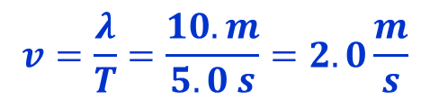
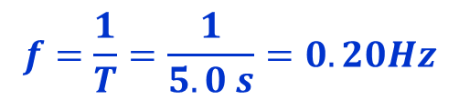

Example
A physics student went to the beach on their summer vacation where they noticed a fishing vessel that was 10. m in length fishing about 200 m from shore. The student saw that the boat perfectly fit between two crests (bow to stern) approximately once every 5.0 seconds.
Determine the:
  Wavelength
  Period
  Frequency
  Speed of the waves.
10 m
5.0 s
$$f=\frac{1}{T}=\frac{1}{5.0 s}=0.20Hz$$
$$v=\frac{λ}{T}=\frac{10. m}{5.0 s}=2.0\frac{m}{s}$$
or $v=fλ=\left(0.20Hz\right)\left(10. m\right)=2.0\frac{m}{s}$

Slide 13
Waves at Boundaries
Interference and Standing Waves

Slide 14
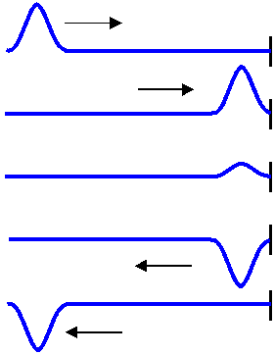
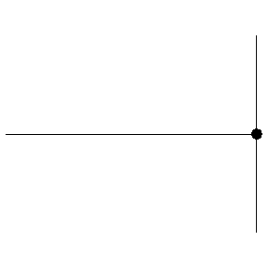
Waves at Fixed Boundaries
A wave incident upon a fixed boundary will have its energy reflected back in the opposite direction. Note that the wave pulse is inverted after reflecting off the boundary.
Single pulse or disturbance
Incident Wave
Reflected Wave
www.electron4.phys.utk.edu

Slide 15
Interference
Interference occurs whenever two waves occupy the same space at the same time.
  Law of Linear Superposition: When two or more waves are present at the same time at the same place, the resultant disturbance is equal to the sum of the disturbances from the individual waves.

Slide 16

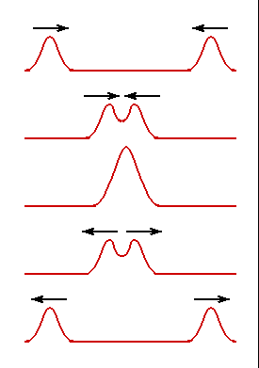
Constructive Wave Interference
Constructive Interference – Process by which two waves meet producing a net larger amplitude.
www.electron4.phys.utk.edu

Slide 17
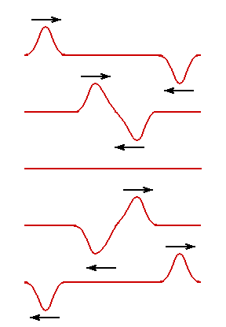
Destructive Wave Interference
Destructive Interference – Process by which two waves meet canceling out each other.

Slide 18
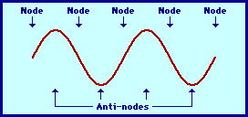
Standing Waves
Standing Wave: An interference pattern resulting from two waves moving in opposite directions with the same frequency and amplitude such that they develop a consistent repeating pattern of constructive and destructive interference.
  Node: The part of a standing wave where interference is destructive at all times (180º out of phase).
  Antinode: The part of the wave where interference is maximized constructively (in phase).
  Standing Wave

Slide 19

The Anatomy of a Standing Wave

Slide 20
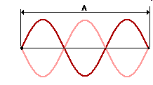
The Parts of a Standing Wave
Note: there is always one more node than antinode.
  How many nodes do you see?
  How many antinodes do you see?
  What is the distance between two nodes?
  What is the distance between two antinodes?
Antinodes
λ
Amplitude
Nodes

Slide 21

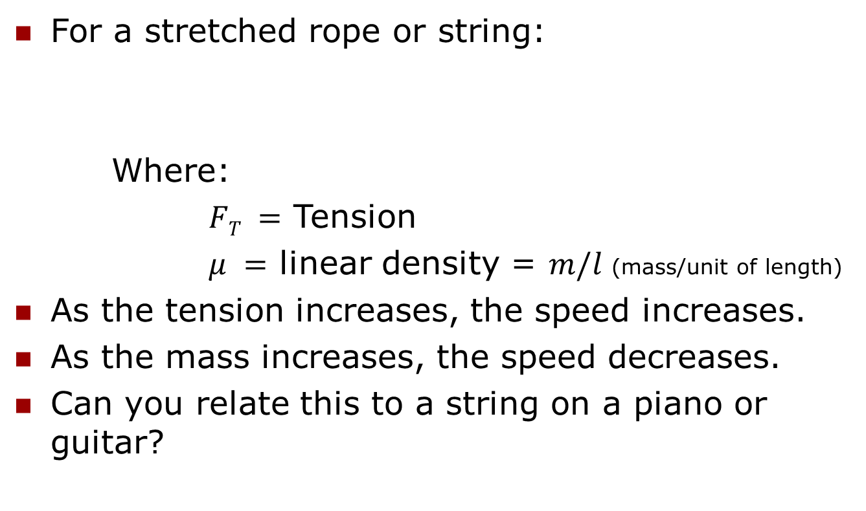
Speed of a Wave on a String
For a stretched rope or string:
Where:
$FT =$ Tension
$μ =$ linear density = $m/l$ (mass/unit of length)
As the tension increases, the speed increases.
As the mass increases, the speed decreases.
Can you relate this to a string on a piano or guitar?
$$v =\sqrt{\frac{F_{T}}{μ}}$$

Slide 22
Continuous Waves
When a wave impacts a boundary, some of the energy is reflected, while some passes through.
The wave that passes through is called a transmitted wave.
A wave that is transmitted through a boundary will lose some of its energy.
  Electromagnetic radiation will both slow down and have a shorter wavelength when going into a denser media.
  Sound will increase in speed when transitioning into a denser media.
Speed of Light in different mediums

Slide 23
Continuous Waves – Higher Speed to Lower Speed
Note the differences in wavelength and amplitude between of the wave in the two different mediums
Incident + Reflected Wave
Transmitted Wave
v₁
-v₁
v₂
Displacement
Boundary
Higher speed
Longer wavelength
Lower speed
Shorter wavelength
Note: This phenomena is seen with light traveling from air to water.

Slide 24
The Wave Equation
Sinusoidal waves can be represented by the following equation.
y(x,t) = y_{m}sin(ωt - κx)
Where:
y_{m} = amplitude
κ = angular wave number (2π/λ)
x = position
ω = angular frequency (2πf)
t = time
Note that the sum (ωt - κx) is in radians, not degrees.

Slide 25
The Wave Equation
y(x,t) = y_{m}sin(ωt - κx)
κ = 2π/λ
Waveform
repeats itself every 2π.
ω = 2πf
Waveform
travels through 1
period (T) every 2π.
A phase constant (φ) can be included in the phase that represents all waves that do not pass through the origin.
Phase
Amplitude
+x
λ

Slide 26
The Wave Equation – An Alternate Representation
y(x,t) = y_{m}sin(ωt - κx)
Substituting for ω (2πf), κ (2π/λ) and y_{m} (A) yields:
y(x,t) = Asin2π(ft - x)
or
y(x,t) = Asin2π(vt - x)
1
λ
λ

Slide 27
Waves at Boundaries
Examples of Waves at Boundaries
Wave Types (Cutnell & Johnson)
Waves - Colorado.edu

Slide 28
Key Ideas
Waves transfer energy without transferring matter.
Longitudinal waves like that of sound require a medium.
Transverse waves such as electro-magnetic radiation (light) do not require a medium.
In transverse waves, displacement is perpendicular to the direction of the wave while in longitudinal waves, the displacement is in the same direction.

Slide 29
Key Ideas
Waves can interfere with one another resulting in constructive or destructive interference.
Standing waves are a special case of constructive and destructive interference for two waves moving in opposite directions with the same amplitude, frequency and wavelength.

